Slide 1

Geometry
Unit 6, Lesson 4 Sequence of Transformations Volume 1, pg. 301

Slide 2


Benchmarks
MA.912.GR.2.2
Identify transformations that do or do not preserve distance.
MA.912.GR.2.3
Specify a sequence of transformations that will map a given figure onto itself or onto another congruent or similar figure.
volume 1, pg. 301

Slide 3
Integrated Mathematical Thinking and Reasoning Standards
MA.K12.MTR.4.1 Engage in discussions that reflect on the mathematical thinking of self and others.
MA.K12.MTR.5.1 Use patterns and structure to help understand and connect mathematical concepts.
MA.K12.MTR.6.1 Assess the reasonableness of solutions.
volume 1, pg. 301

Slide 4

Learning Targets
I can represent a sequence of transformations that will map the preimage onto the image.
I can describe a sequence of transformations that will map the preimage onto the image.
I can identify transformations that do or do not preserve distance.
I can use a description of a sequence of transformations to determine if the transformation does or does not preserve distance.
volume 1, pg. 301

Slide 5

Warm-Up
volume 1, pg. 302

Slide 6
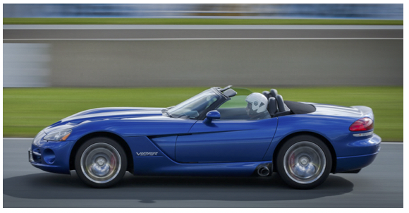
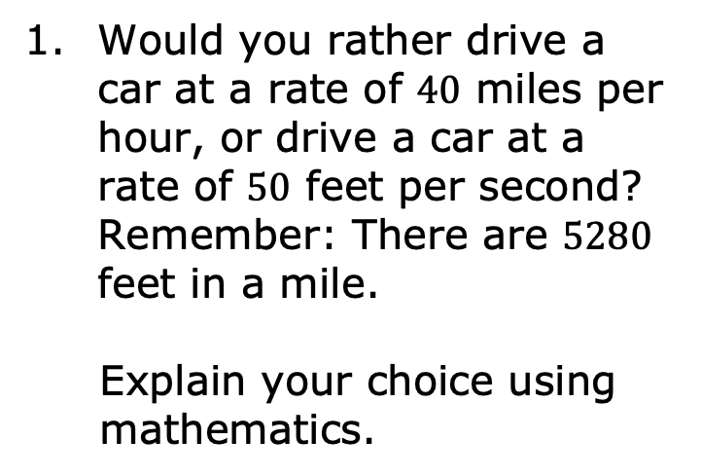
6.4.1 Warm-Up: Would You Rather?
Would you rather drive a car at a rate of $40$ miles per hour, or drive a car at a rate of $50$ feet per second? Remember: There are $5280$ feet in a mile.
Explain your choice using mathematics.
volume 1, pg. 302

Slide 7

Guided Instruction
volume 1, pg. 302

Slide 8
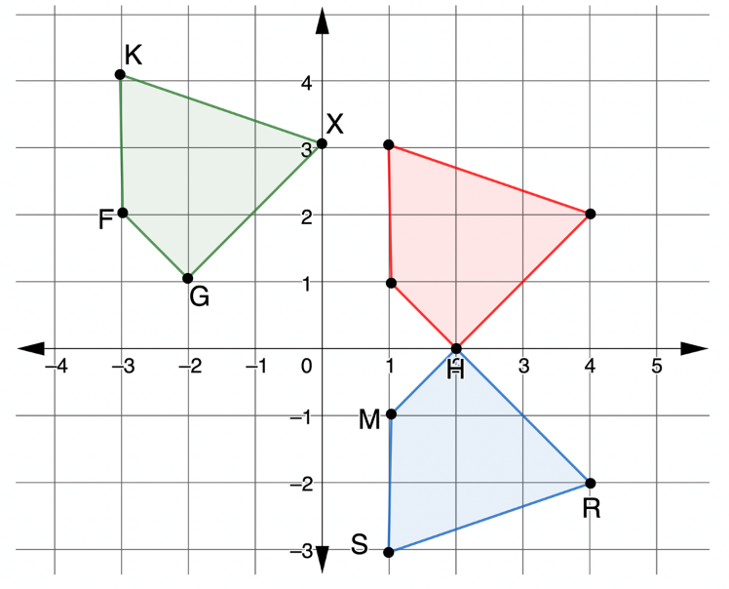

6.4.2 Guided Instruction: Sequence of Transformations
$XGFK$ is the result of a sequence of transformations of $RSMH$. The red quadrilateral is the first transformation.
Describe the first transformation of $RSMH$.
volume 1, pg. 302

Slide 9
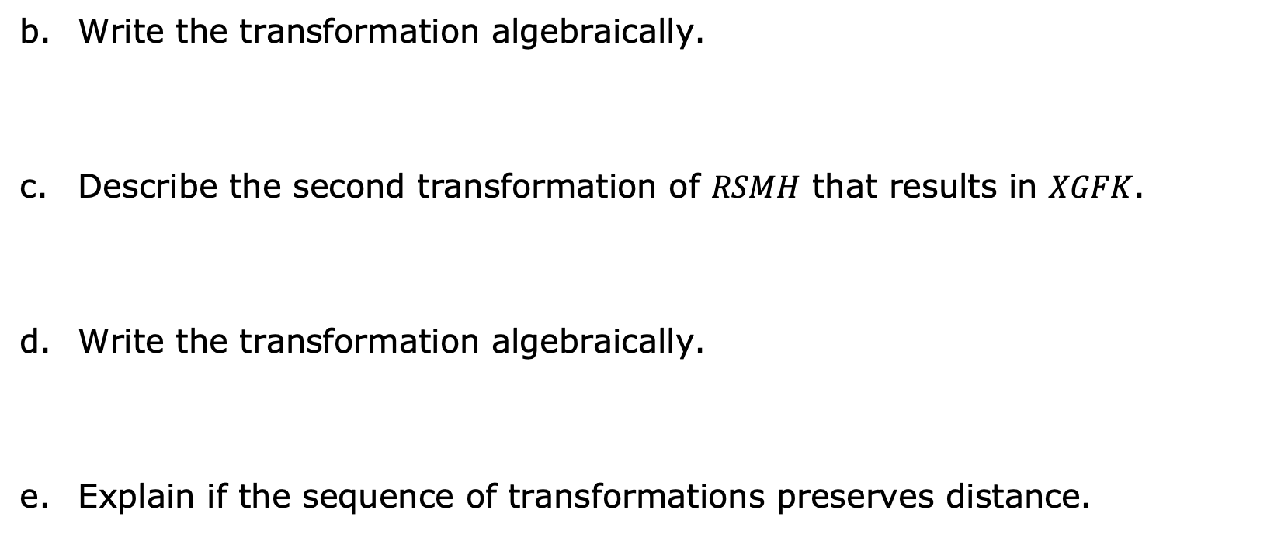
Write the transformation algebraically.
Describe the second transformation of $RSMH$ that results in $XGFK$.
Write the transformation algebraically.
Explain if the sequence of transformations preserves distance.
volume 1, pg. 303

Slide 10
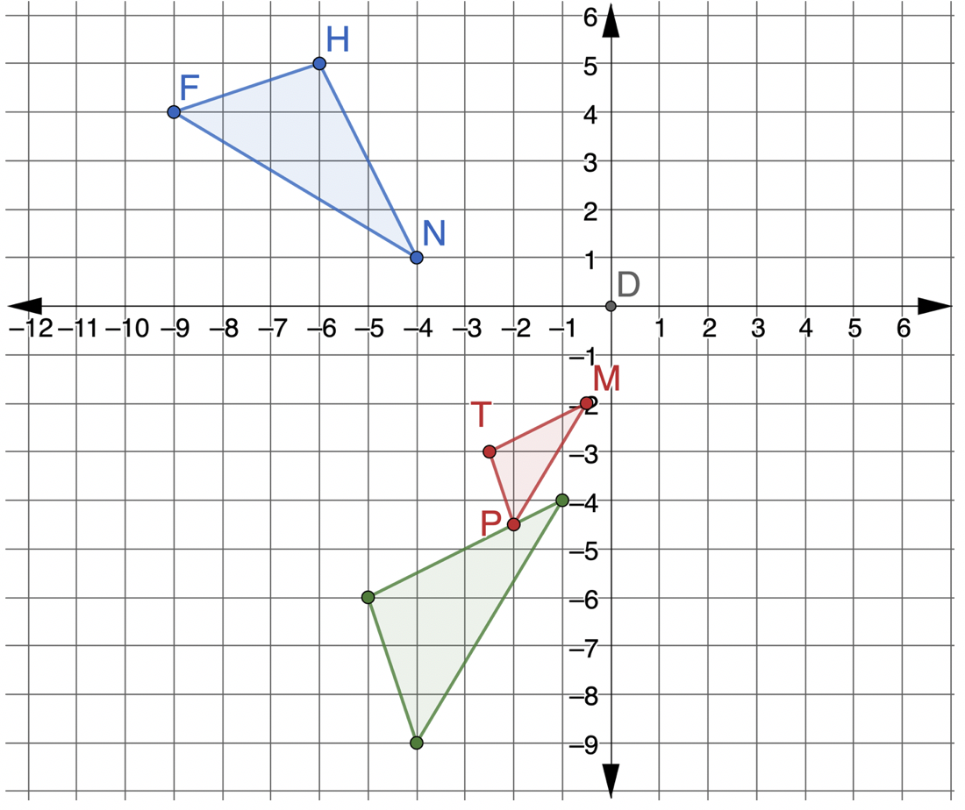
$∆MTP$ is the result of a sequence of transformations of $∆HNF$.
volume 1, pg. 303

Slide 11
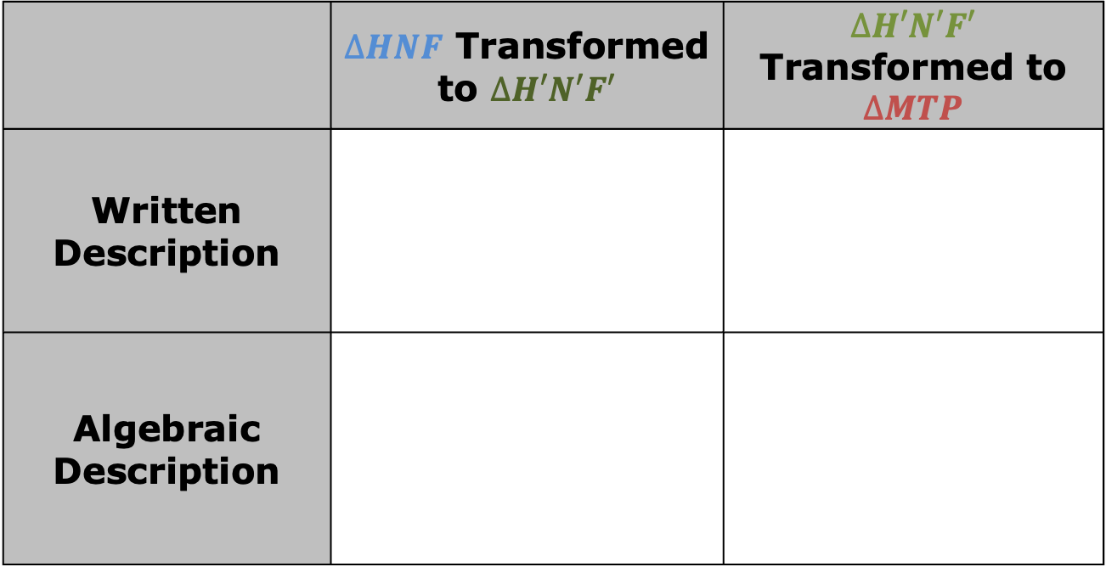
Determine the sequence of transformations that will map $∆HNF$ onto $∆MTP$. Complete the table.
 | $∆HNF$ Transformed to $∆H′N′F′$ | $∆H′N′F′$ Transformed to $∆MTP$
Written Description
Algebraic Description
volume 1, pg. 303

Slide 12
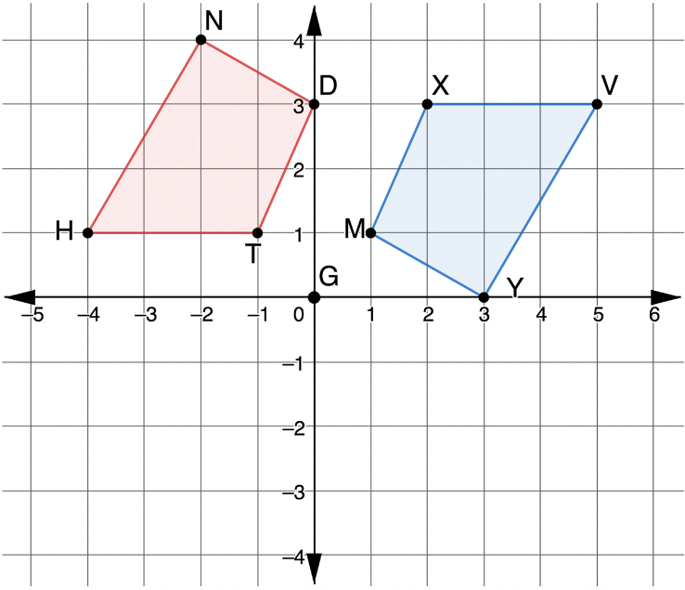
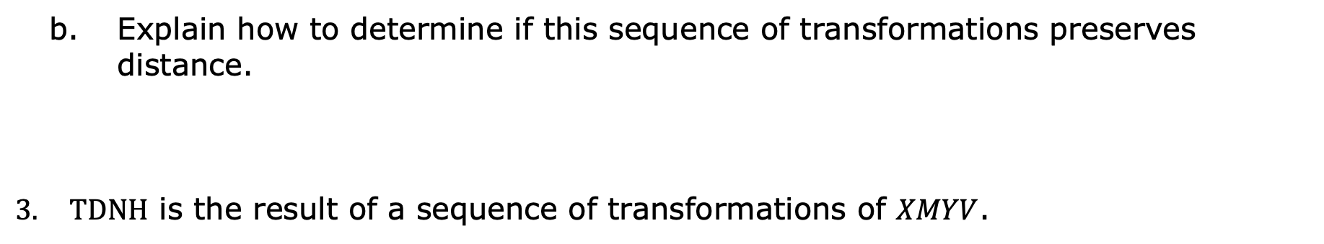
Explain how to determine if this sequence of transformations preserves distance.
$TDNH$ is the result of a sequence of transformations of $XMYV$.
volume 1, pg. 304

Slide 13

Determine a sequence of transformations that will map $XMYV$ onto $TDNH$. Complete the table.
Which transformations preserve distance?
 | First Transformation | Second Transformation
Written Description
Algebraic Description
volume 1, pg. 304

Slide 14

Guided Practice
volume 1, pg. 305

Slide 15

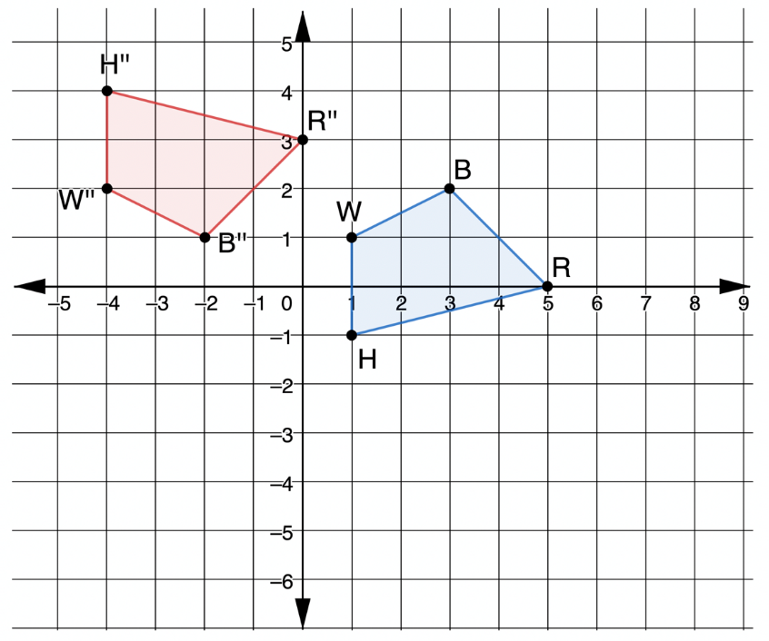
6.4.3 Guided Practice: Mapping a Given Preimage Onto an Image
$WBRH$ was transformed by a sequence of transformations to create $W′′B′′R′′H′′$.
volume 1, pg. 305

Slide 16
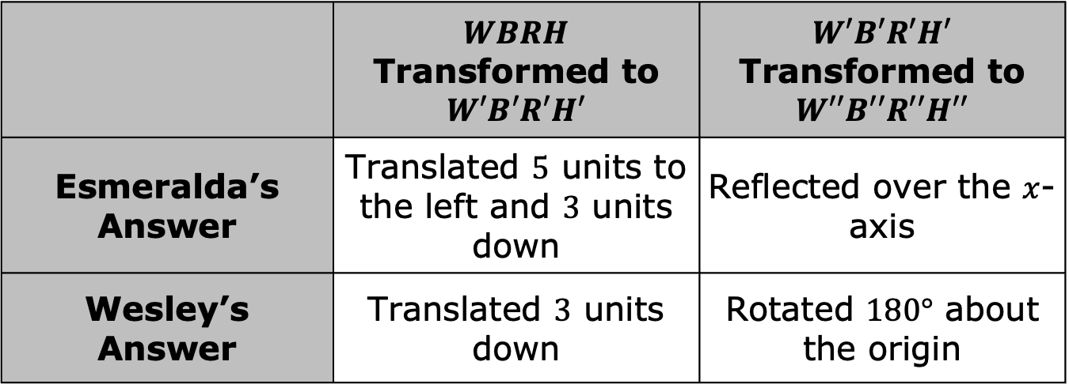
Esmeralda and Wesley were determining the sequence of transformations and wrote their answers in the table.
 | $WBRH$ Transformed to $W′B′R′H′$ | $W′B′R′H′$ Transformed to $W′′B′′R′′H′′$
Esmeralda’s Answer | Translated $5$ units to the left and $3$ units down | Reflected over the $x$-axis
Wesley’s Answer | Translated $3$ units down | Rotated $180°$ about the origin
volume 1, pg. 305

Slide 17
1. Determine whose sequence of transformations is correct. Explain your reasoning.
volume 1, pg. 305

Slide 18

Your Turn
volume 1, pg. 306

Slide 19
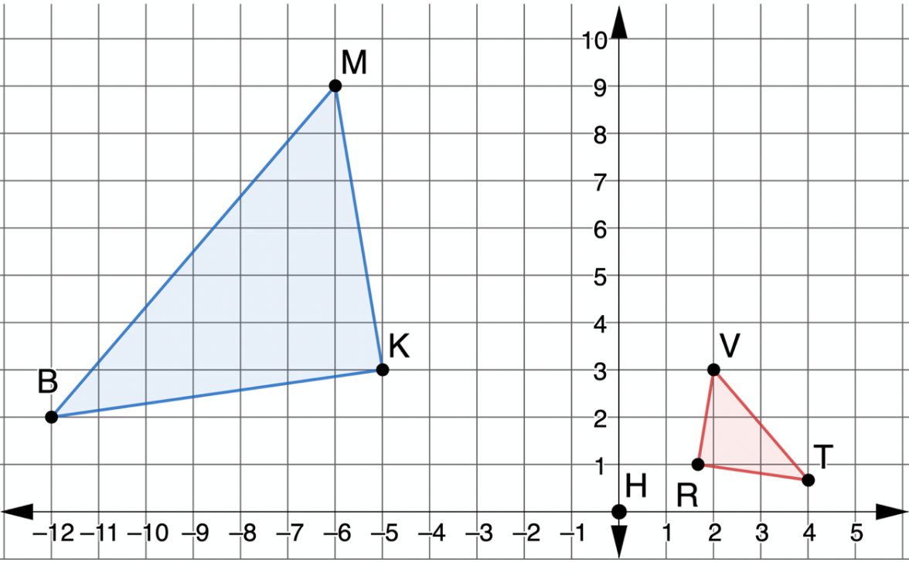
6.4.4 Your Turn!
$∆MKB$ was transformed to create $∆VRT$.
volume 1, pg. 306

Slide 20
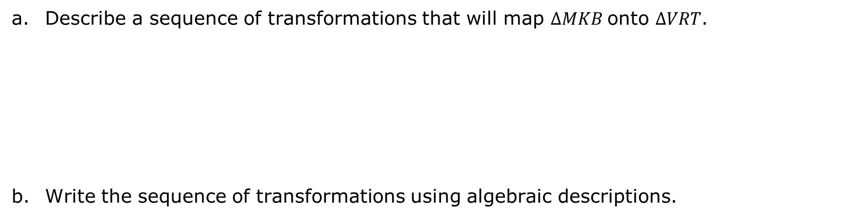
Describe a sequence of transformations that will map $∆MKB$onto $∆VRT$.
Write the sequence of transformations using algebraic descriptions.
volume 1, pg. 306

Slide 21

Wrap-Up
volume 1, pg. 306

Slide 22
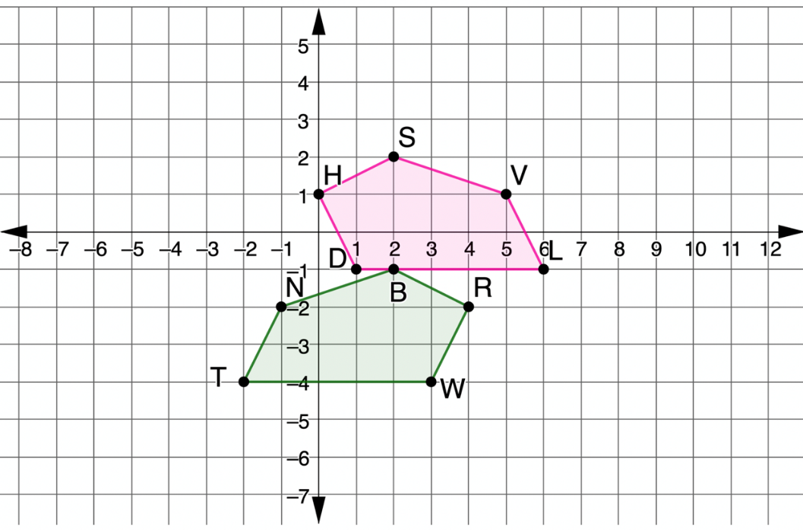
6.4.5 Wrap-Up: Ticket Out the Door
A sequence of transformations can map $NBRWT$ onto $VSHDL$.
volume 1, pg. 306

Slide 23
Determine a sequence of transformations that will map $NBRWT$ onto $VSHDL$. Complete the table.
 | First Transformation | Second Transformation
Written Description
Algebraic Description
volume 1, pg. 306

